Slide 1
MIS 3301 Intro. to Business Programming Logic
Files and Exceptions
Part 2 – Exception Types; Exception Handling
Mrs. Nancy G. Sánchez

Slide 2
Errors & Exceptions

Slide 3
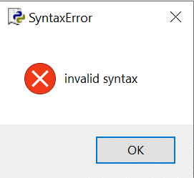
Errors
Syntax Error
Logic Error
An error in the syntax/formation of a python statement
Doesn’t run
Runs without crashing
Produces incorrect results
def main():
a = 20
b = 10
if a > b:
print('A is greater')
elif a = b:
print('A and B are equal')
else:
print('B is greater')
main()
def main():
hours = 40
pay_rate = 20.00
total_pay = hours + pay_rate
print('Total:', format(total_pay, '.2f'))
main()
Total: 60.00
Should be:
Total: 800.00

Slide 4
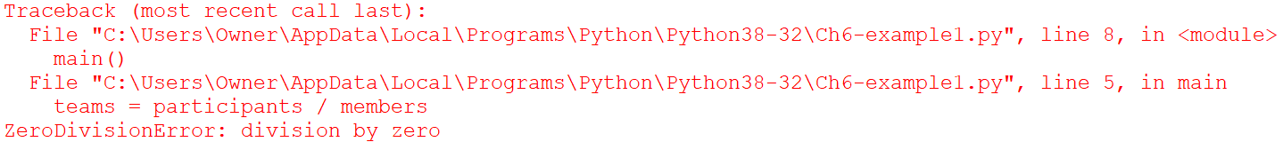
Exception
Exception - an error that occurs while a program is running
When code crashes, the Python Interpreter displays a traceback
When an exception occurs,
we say that
“an exception was raised”
You see the Traceback when you have an “unhandled exception”!
We can write code to
“catch an exception”
– using the try/except statement
We can instead display a more graceful message…
You must enter a value greater than 0.
You must have at least one member per team.

Slide 5
Python Exception Hierarchy
FYI only … These are all of the built-in exceptions in Python.
BaseException
+-- SystemExit
+-- KeyboardInterrupt
+-- GeneratorExit
+-- Exception
+-- StopIteration
+-- StopAsyncIteration
+-- ArithmeticError
| +-- FloatingPointError
| +-- OverflowError
| +-- ZeroDivisionError
+-- AssertionError
+-- AttributeError
+-- BufferError
+-- EOFError
+-- ImportError
| +-- ModuleNotFoundError
+-- LookupError
| +-- IndexError
| +-- KeyError
+-- MemoryError
+-- NameError
| +-- UnboundLocalError
+-- OSError
| +-- BlockingIOError
| +-- ChildProcessError
| +-- ConnectionError
| | +-- BrokenPipeError
| | +-- ConnectionAbortedError
| | +-- ConnectionRefusedError
| | +-- ConnectionResetError
| +-- FileExistsError
| +-- FileNotFoundError
| +-- InterruptedError
| +-- IsADirectoryError
| +-- NotADirectoryError
| +-- PermissionError
| +-- ProcessLookupError
| +-- TimeoutError
+-- ReferenceError
+-- RuntimeError
| +--
NotImplementedError
| +-- RecursionError
+-- SyntaxError
| +-- IndentationError
| +-- TabError
+-- SystemError +-- TypeError
+-- ValueError
| +-- UnicodeError
| +-- UnicodeDecodeError
| +-- UnicodeEncodeError
| +-- UnicodeTranslateError
+-- Warning
+-- DeprecationWarning
+-- PendingDeprecationWarning
+-- RuntimeWarning
+-- SyntaxWarning
+-- UserWarning
+-- FutureWarning
+-- ImportWarning
+-- UnicodeWarning
+-- BytesWarning
+-- EncodingWarning
+-- ResourceWarning
TypeError
Source: https://docs.python.org/3/library/exceptions.html

Slide 6
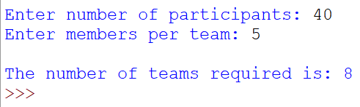
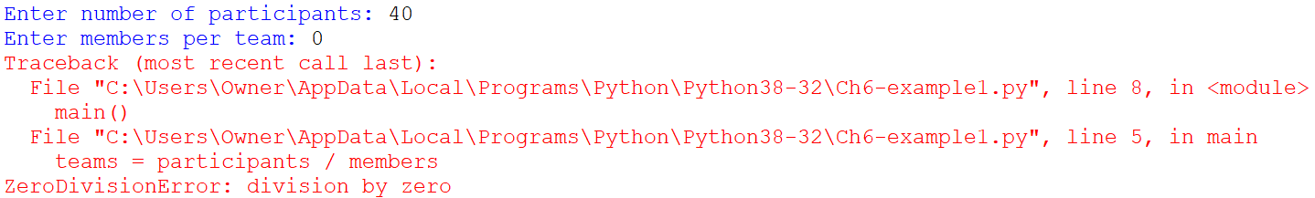
Exception: ZeroDivisionError
ZeroDivisionError
This exception is raised when the second argument of a division or modulo operation is zero
#Calc the number of teams required
def main():
participants = int(input('Enter number of participants: '))
members = int(input('Enter members per team: '))
teams = participants / members
print('\nThe number of teams required is:', int(teams))
main()
Traceback
Exception
name
Error
message
Function/Module

Slide 7
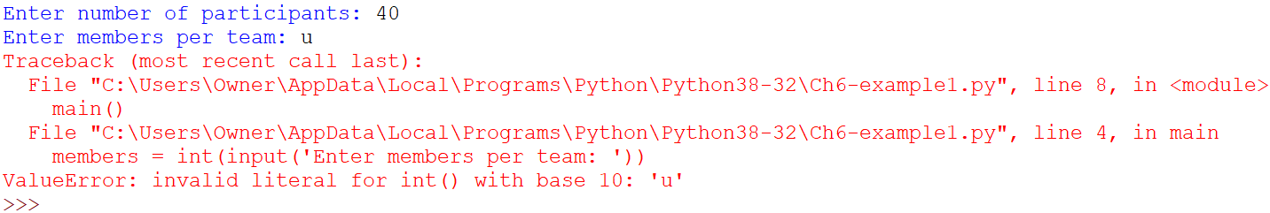
Exception: ValueError
ValueError
This exception is raised with data conversion when an operation or function receives an argument with an inappropriate value for the data type.
#Calc the number of teams required
def main():
participants = int(input('Enter number of participants: '))
members = int(input('Enter members per team: '))
teams = participants / members
print('\nThe number of teams required is:', int(teams))
main()
Passing the int() an argument of:
'5' is fine
'u' is invalid
Traceback

Slide 8
A few more Exceptions
FileNotFoundError: [Errno 2] No such file or directory: 'any_file.csv'
open('any_file.csv', 'r')
→ Raised when a file or directory is requested but doesn’t exist.
PermissionError: [Errno 13] Permission denied: 'any_file.csv'
open('any_file.csv', 'w')
→ Raised when the actual file is open and you are using the open() function to write to it.

Slide 9
Exception Handling

Slide 10
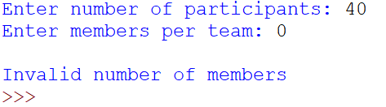
Writing Additional Code: to handle each type of error
You can prevent some errors by validating data up front.
BUT…You would have to add additional tests to validate other situations (e.g. to test if someone entered a string).
#Calc the number of teams required
def main():
participants = int(input('Enter number of participants: '))
members = int(input('Enter members per team: '))
if members != 0:
teams = participants / members
print('\nThe number of teams required is:', int(teams))
else:
print('\nInvalid number of members’)
main()

Slide 11
try/except statement
We can add safeguards to our code by writing Exception Handlers
This allows us to intercept an exception when it is raised so that our code doesn’t crash.
try:
except:
else:
finally:
#run this code
Required!
Can have more than 1 except clauses
#if an exception has been raised, run this code
Optional
#else if an exception has NOT been raised, run this code
Optional
#always run this code

Slide 12
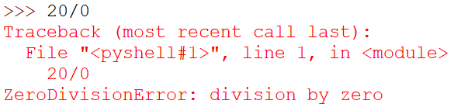
try/except statement
try:
20/0
except:
print('Invalid value')

Slide 13
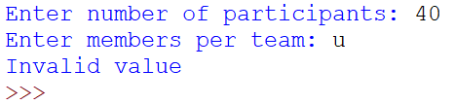
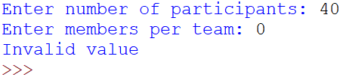
try/except statement
#Calc the number of teams required
def main():
try:
participants = int(input('Enter number of participants: '))
members = int(input('Enter members per team: '))
teams = participants / members
print('\nThe number of teams required is:', int(teams))
except:
print('Invalid value')
main()
Try suite/block
Exception Handler

Slide 14
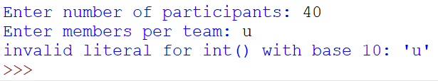
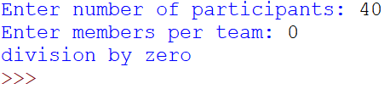
“Catch” ANY Exception
#Calc the number of teams required
def main():
try:
participants = int(input('Enter number of participants: '))
members = int(input('Enter members per team: '))
teams = participants / members
print('\nThe number of teams required is:', int(teams))
except:
print('Invalid value')
main()
#Calc the number of teams required
def main():
try:
participants = int(input('Enter number of participants: '))
members = int(input('Enter members per team: '))
teams = participants / members
print('\nThe number of teams required is:', int(teams))
except Exception as err:
print(err)
main()
err: Exception object

Ok!
More
informative!


Slide 15
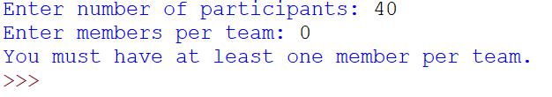
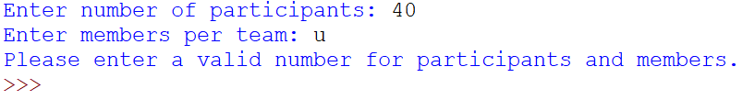
“Catch” Specific Exceptions
Best – specific messages!
#Calc the number of teams required
def main():
try:
participants = int(input('Enter number of participants: '))
members = int(input('Enter members per team: '))
teams = participants / members
print('\nThe number of teams required is:', int(teams))
except ZeroDivisionError:
print('You must have at least one member per team.')
except ValueError:
print('Please enter a valid number for participants and members.')
except:
print('An error ocurred.')
main()
Can also display a specific Exception object
except ZeroDivisionError as err:
print(err)

Slide 16
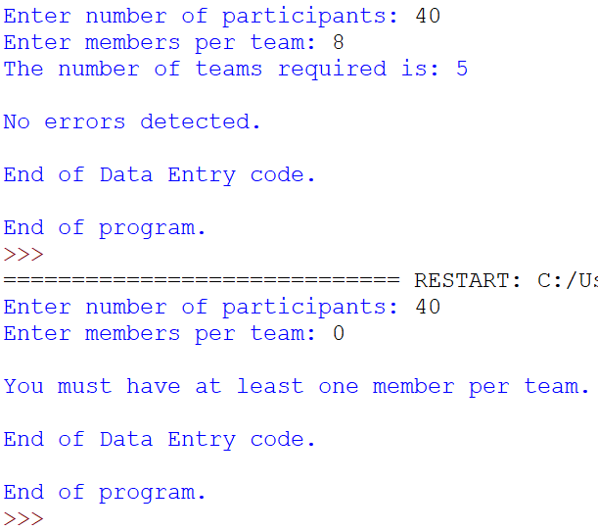
Example with ALL clauses
#Calc the number of teams required
def main():
try:
participants = int(input('Enter number of participants: '))
members = int(input('Enter members per team: '))
teams = participants / members
print('The number of teams required is:', int(teams))
except ZeroDivisionError:
print('\nYou must have at least one member per team.')
except ValueError:
print('\nPlease enter a valid number for participants and members.')
except:
print('\nAn unexpected error ocurred.')
else:
print('\nNo errors detected.')
finally:
print('\nEnd of Data Entry code.')
print('\nEnd of program.')
main()
When there are no exceptions raised:
When an exception is raised (and handled):

Slide 17
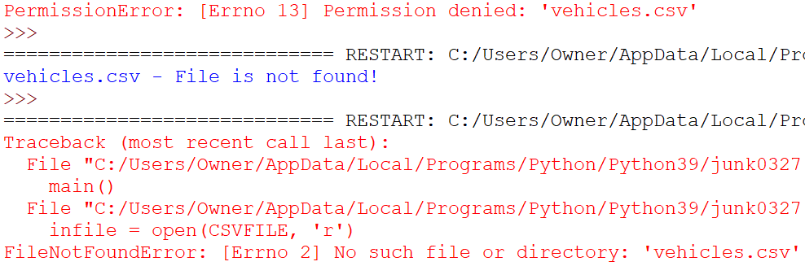
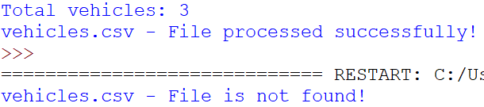
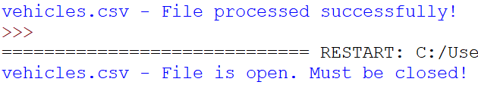
Exception Handling & Opening Files
Another option
import os.path
import sys
if not os.path.exists(CSVFILE):
print('File is missing')
sys.exit()
Reading from a File
Writing to a File
import csv
CSVFILE = 'vehicles.csv'
def main():
try:
infile = open(CSVFILE, 'r')
reader = csv.reader(infile)
#add code to read the file
infile.close()
except FileNotFoundError:
print(CSVFILE + ' - File is not found!')
else:
print(CSVFILE + ' - File processed successfully!')
main()
import csv
CSVFILE = 'vehicles.csv'
def main():
try:
outfile = open(CSVFILE, 'w')
reader = csv.reader(outfile)
#add code to write to the file
outfile.close()
except PermissionError:
print(CSVFILE + ' - File is open. Must be closed!')
else:
print(CSVFILE + ' - File processed successfully!')
main()
If the file does not exist…
If the file is open…

Slide 18
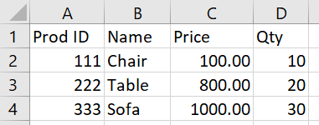
Exercise 3 – Exception Handling
Copy the code below and save it as Ch6-Ex03-Exception-Handling.py
#Ch6-Ex03-Exception-Handling.py
import csv
CSVFILE = 'products.csv'
def main():
infile = open(CSVFILE, 'r')
reader = csv.reader(infile)
next(reader)
for row in reader:
print('-'*28)
print('Prod ID:', row[0])
print('Name: ', row[1])
print('Price: ', row[2])
print('Qty: ', row[3])
infile.close()
main()
products.csv
Run this code & make sure it works.
If it doesn’t, make sure you have the 'products.csv’ file in the same folder as your code.
Now, change the file referenced in the code to products99.csv. Notice the error message.
Now, add an exception handler
Take your mainline logic and move it into a try clause.
Add an except caluse in the event that the file is missing (FileNotFoundError), the code does not crash
Write the message ‘File is missing’
Another handler to handle all other errors
Write the message ‘Unable to complete processing’
Re-run to test your exception handling. Make sure you now see a more graceful message?

